Slide 1
How to Participate in the Cooperative Professionals Guild Member Directory
Create and update your member profile and control your privacy settings to share information with other members and the public via the Member Directory

Slide 2
About the Member Directory
The Guild maintains a Directory of its members on its association website at https://coopguild.wildapricot.org/
The Directory currently has two default sort orders: Members by Name and Members by State. Users can also search the Directory by any combination of fields.
The Directory consists of a listings page that displays a limited set of information about all members who choose to participate, and an individual member profile page that is displayed when someone clicks on a member listing.
The Directory has two views: public and members-only, which each display a member’s profile information only if authorized by that member’s privacy settings. The initial default is that a member’s profile is private and not shared with anyone other than Guild admins who may not share that information with others without a member’s permission.
Each member is responsible for completing and maintaining their own profile and defining their own privacy settings. The Guild will not share member information with other members or the public except as authorized by a member’s privacy settings.

Slide 3
Follow these 9 steps to create and update your member Directory profile and control your privacy settings. Slides below illustrate each step
Go to Guild’s association website at https://coopguild.wildapricot.org/
Log in as member
Select ‘View Profile’
Choose ‘Edit Profile’ and ‘Profile’
Add information to fields in your membership record, then ”Save.” (Fields that start with “*” are displayed on Directory listings pages. If you don’t complete “Workplace Address – State” you’ll appear at the end of the Members by State directory)
Click “Privacy” to edit your privacy settings.
Click “Show profile to others” unless you don’t want to be in the directory at all.
Edit privacy settings for each field. (Choose “Anybody” to include in public and member’s version of the Directory or “Members” to display only to members or “No access” to restrict to Guild admins.)
Check and correct both your listing and profile pages when logged in and after logging out to make sure they display as you intend.

Slide 4
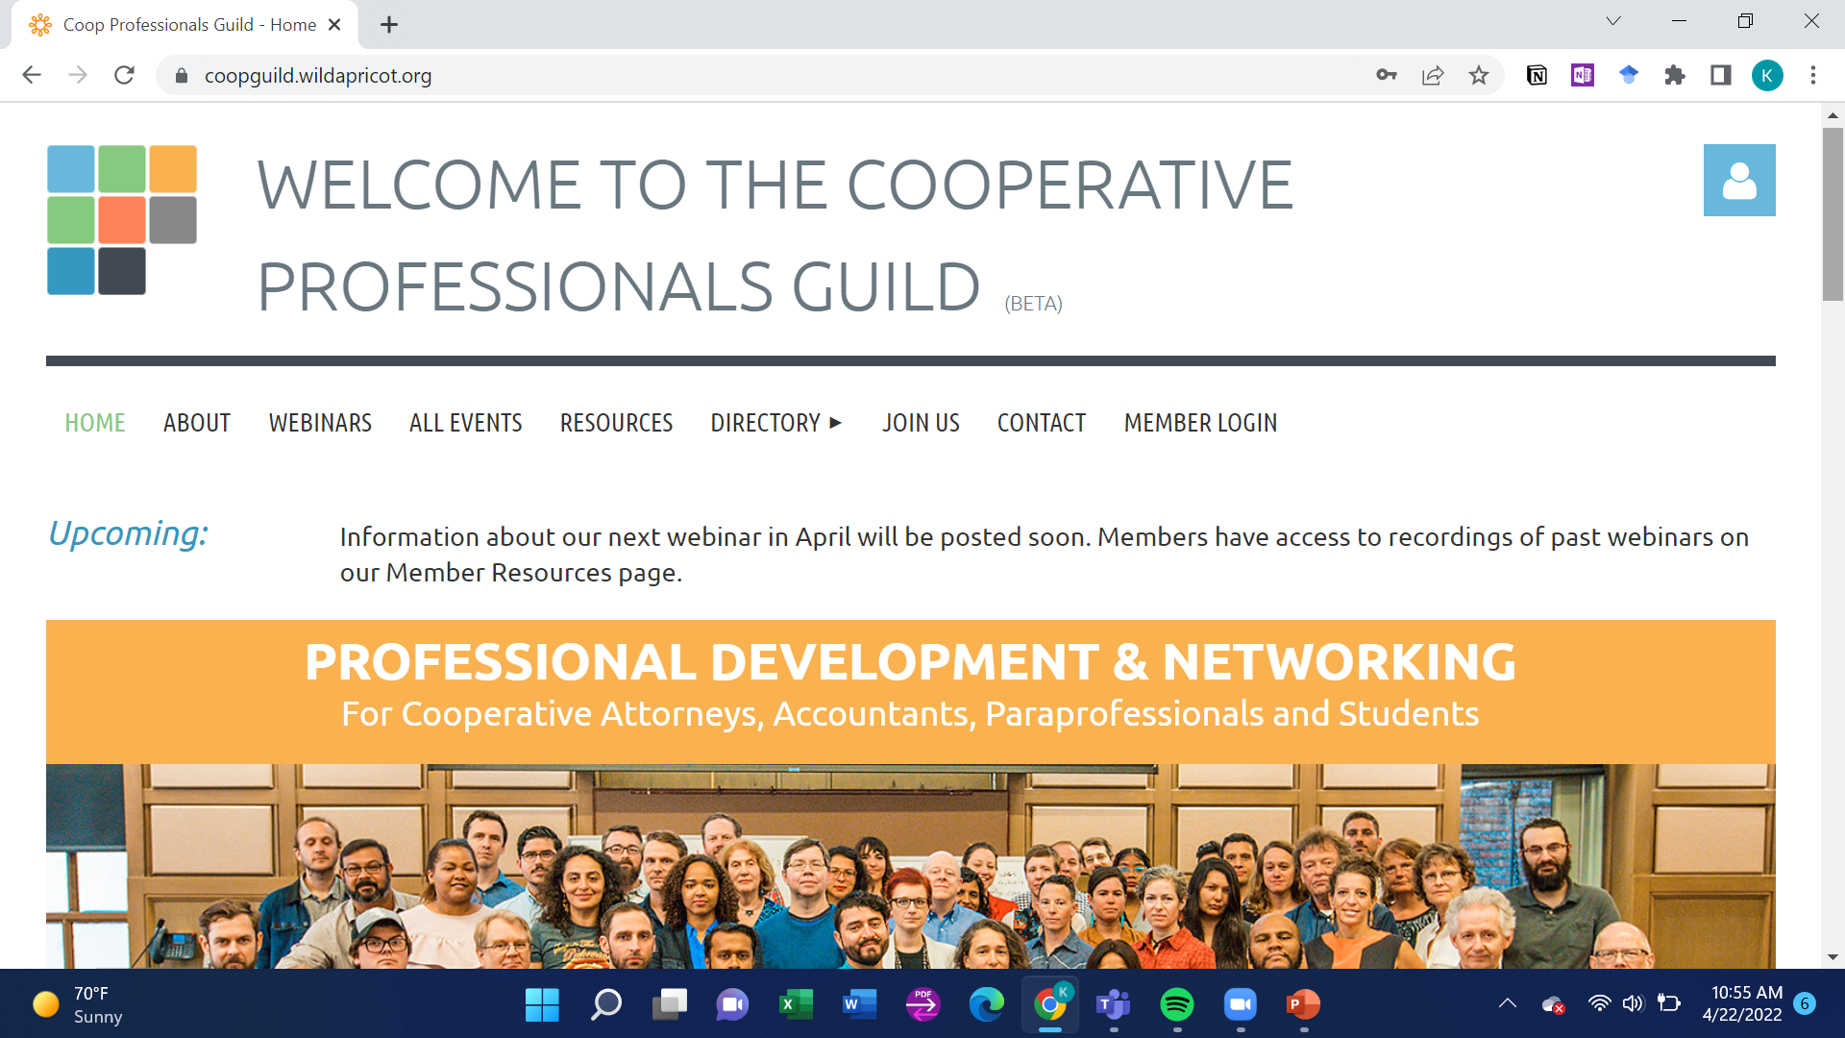
1. Go to the Guild’s new association website: Coopguild.wildapricot.org

Slide 5
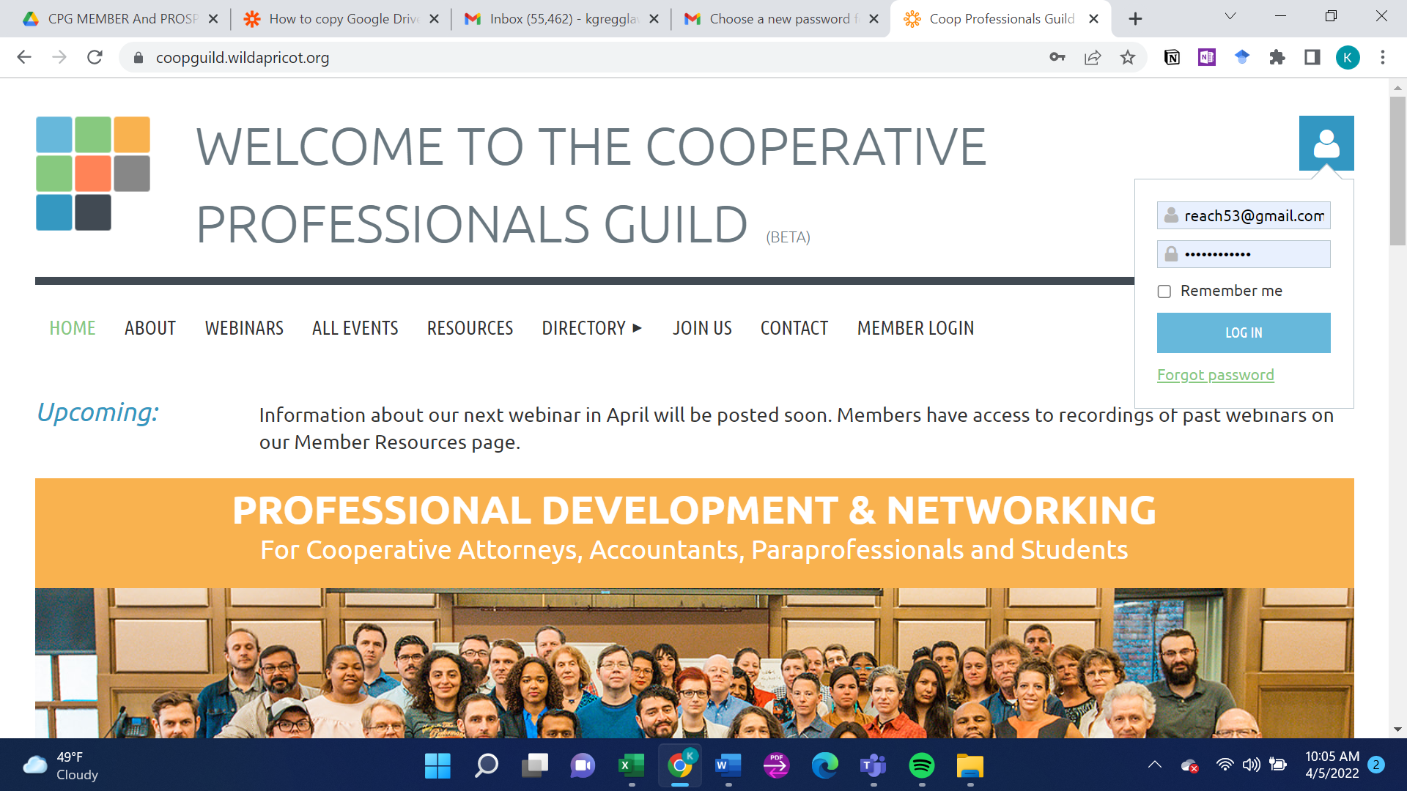
2. Log in
Tip: Click the blue person icon in the upper right-hand corner of any page. Use the password that was emailed to you on or after March 13 or use “Forgot password” option to replace.

Slide 6
Note: The website displays different menu options and content when you are logged in as a member.
Not logged in:
Logged in:

Slide 7
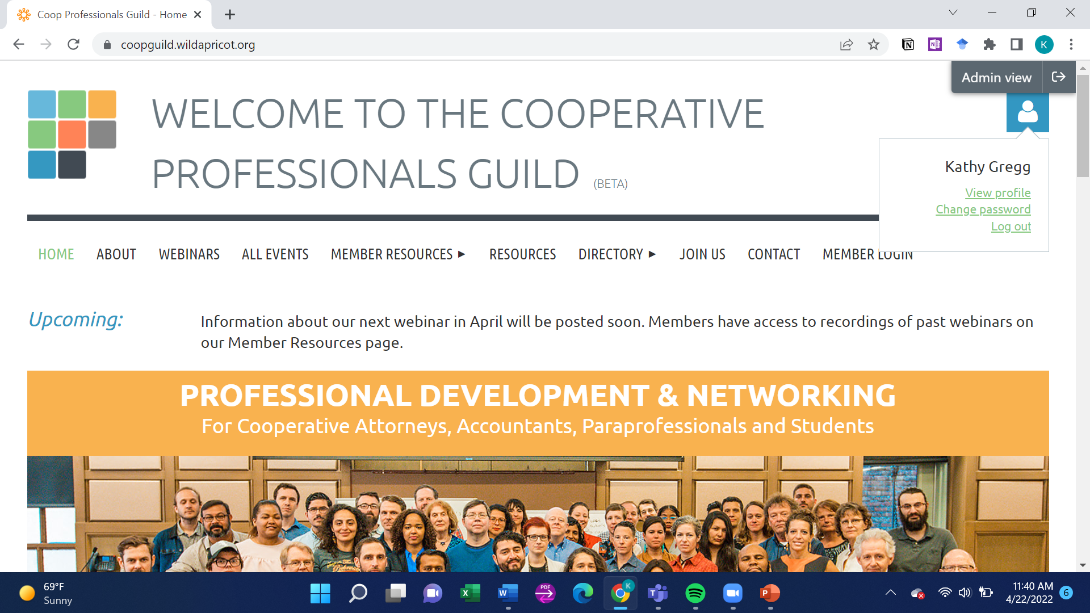
3. Select ‘View Profile’
Tip: Click a second time on the blue person icon in upper right-hand corner to get ‘View profile’ option

Slide 8
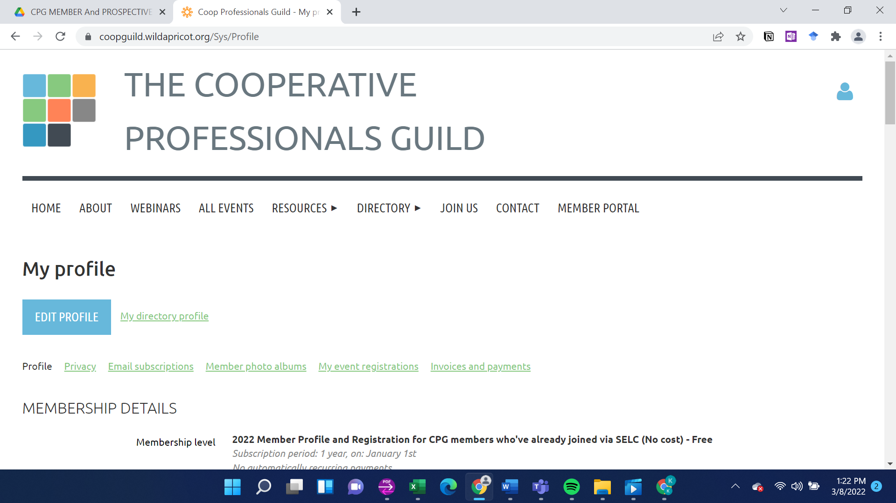
4. Click ‘Edit Profile’ and then click “Profile”

Slide 9
Add information to the Member Profile fields you are willing to share with either other members or Guild admins. Click “SAVE” when you are done.
Note:
There are few required fields other than your name and email address.
You don’t need to fully complete your profile in one session – you can login and update your profile anytime.
No one at the Guild will add or change your profile information or privacy settings unless you authorize this.

Slide 10
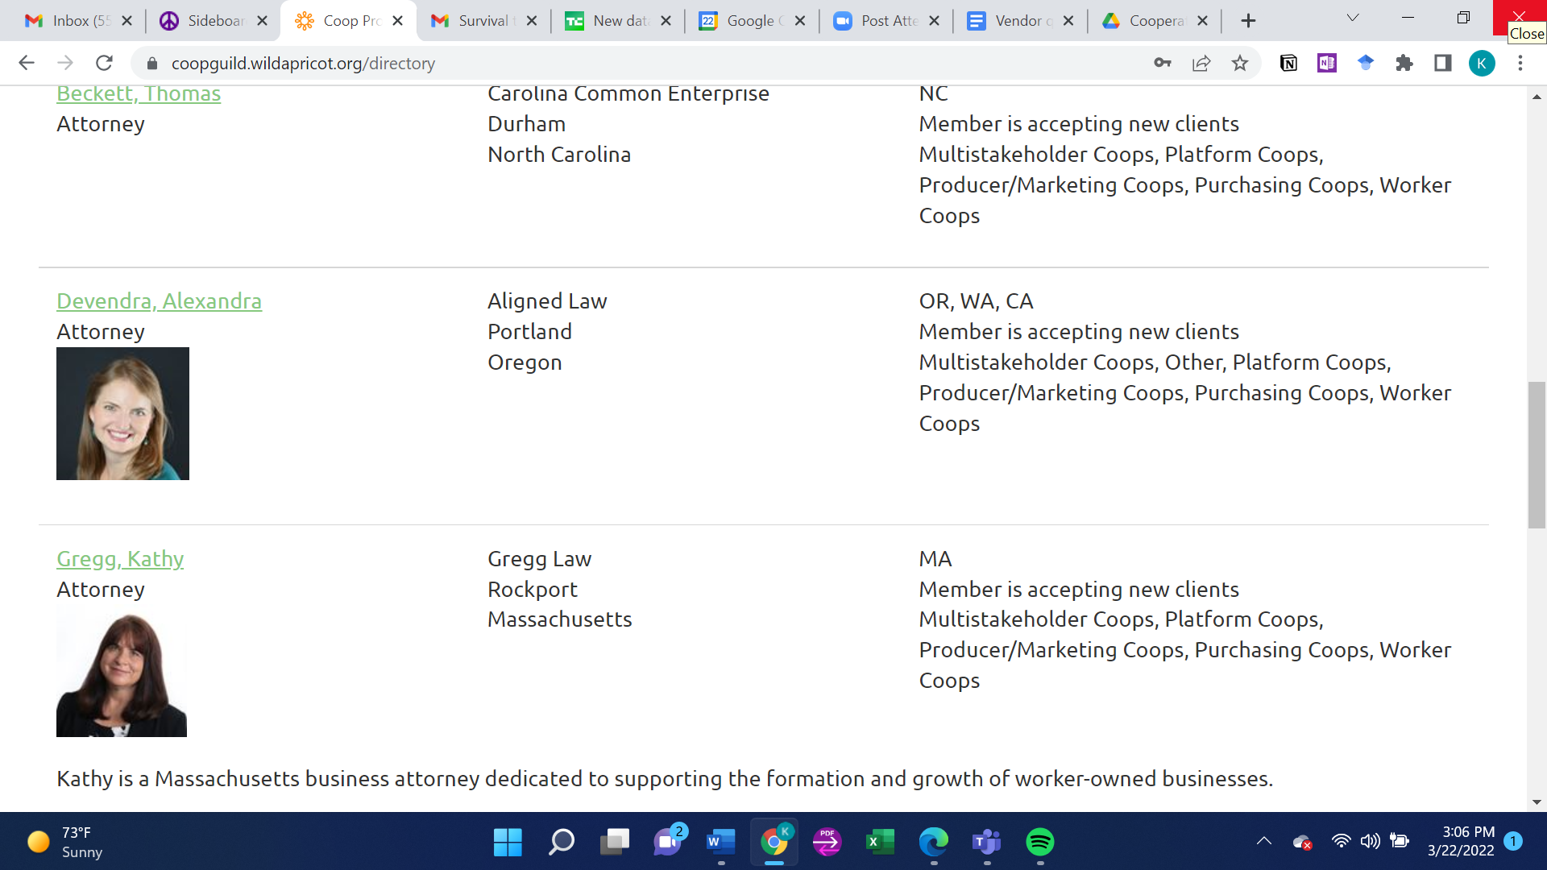
TIP FOR COMPLETING FIELDS FOR THE DIRECTORY LISTING PAGE: The Member Directory listing pages will display the membership profile fields shown in the table below (in three columns and a bottom row) but only if your privacy settings allow and only if you add information to these fields. These fields start with an “*” asterisk in the member profile form to make it easier for you to find and complete them. If you don’t complete “Workplace Address – State” you will appear at the end of the Members by State directory under “View details” instead of under your state.
Last name, First name Profession Photo | Primary Workplace/Affiliation Workplace Address – City Workplace Address – State | State of Practice Member is accepting new clients Coop Sectors Served
Profile summary
Examples

Slide 11
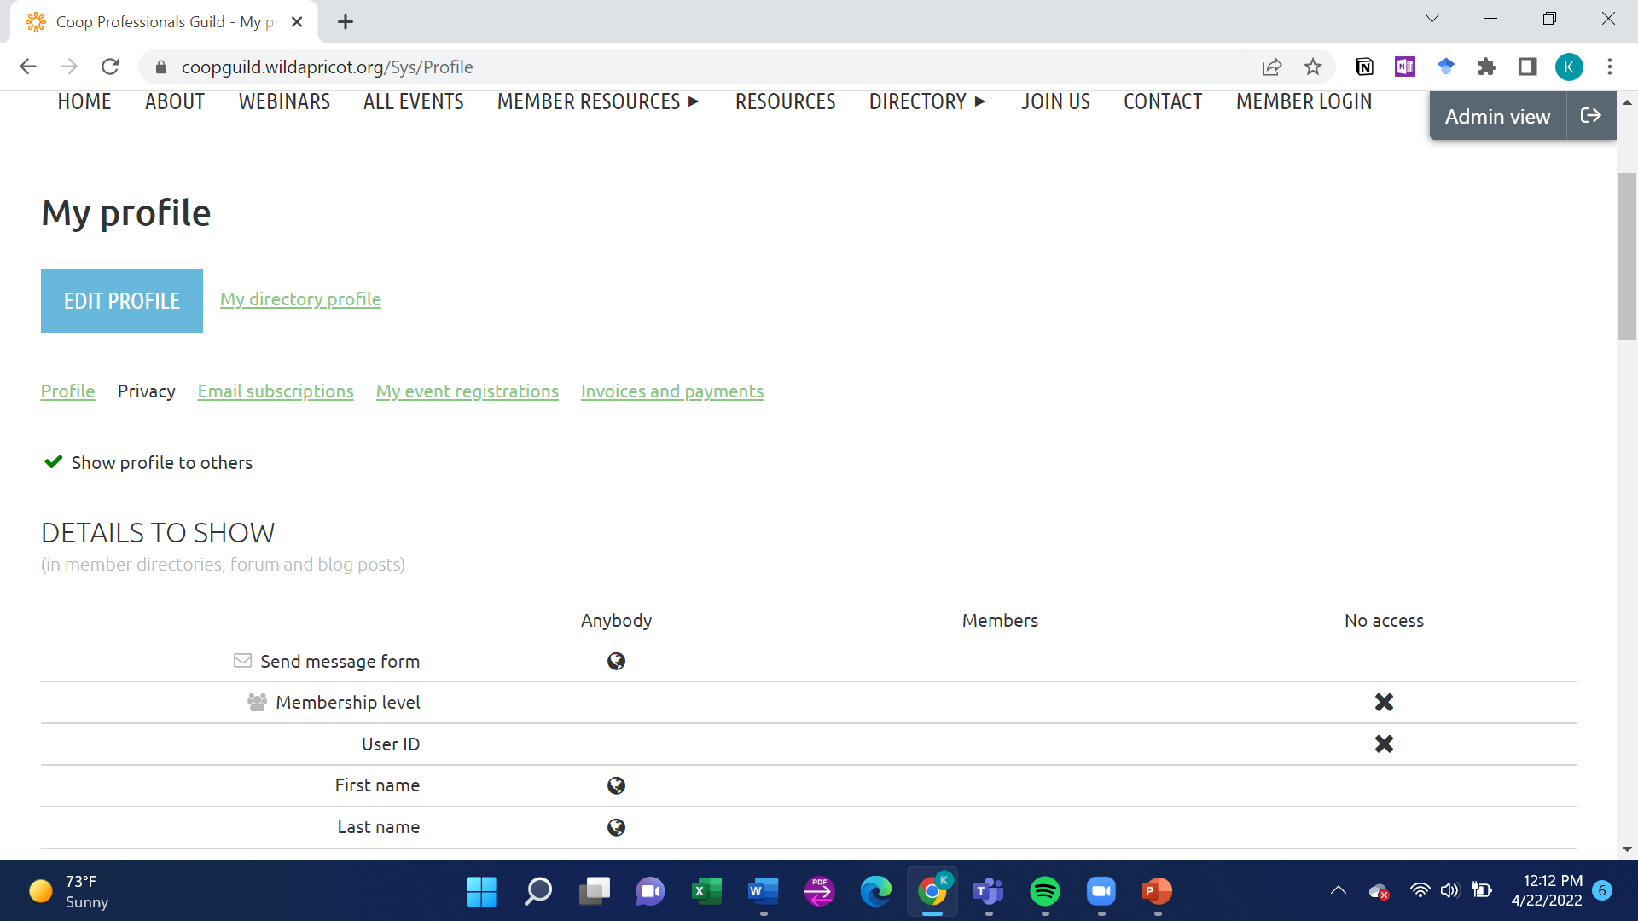
Click ‘Privacy’ to edit privacy settings for your profile (Tip: 1st click ‘Edit Profile’ a second time if you ‘Saved’ profile changes)
Click “Show profile to others” to share any information with others; unclick to keep entire profile private. (Tip: this overrides the privacy settings for individual fields. If you don’t click ‘Show profile to others,’ not even your name will be displayed in the directory, even if the name field privacy settings allow it.)

Slide 12
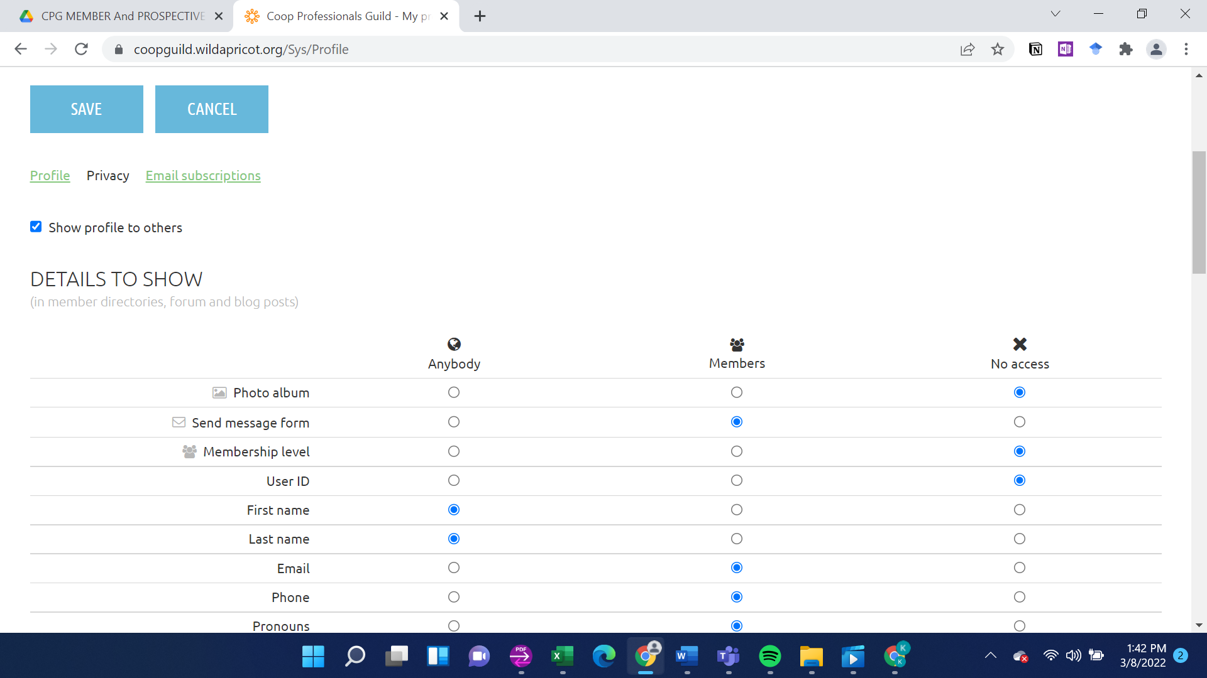
8. Edit privacy settings for each field. Then click ‘Save’
Tip: select ‘Anybody’ to share with members and public, ‘Members’ to share with members only, or ‘No access’ to share only with Guild admins.

Slide 13
9. Check and correct both your Directory listing page and your profile page to make sure they display as you intend. TIP: Look at both pages when logged in as a member (to see what other members see) and when logged out (to see what the public and logged out members see).
Example of different Public views and Member views based on privacy settings:
Public View
Member View (if logged in)

Slide 14
The Guild’s Member Directory is an important part of fulfilling our aim of making access to cooperative professionals easier for everyone and improving networking opportunities for peers.
Thanks for participating in the Member Directory to the fullest extent you feel comfortable doing.

